Slide 1
CHAPTER 1
S2
LIST, QUOTES
NESTED ELEMENTS

Slide 2


OBJECTIVES FOR TODAY
HIM
Lists
Line breaks
Quotes
Nested elements.

Slide 3


HOMEWORK REVIEW
5 MIN
CLASS
Let’s see your work on
Google Classroom…
Notes:
If students didn’t do homeworks ask them why and what was difficult.

Slide 4
WARM UP
WHAT IS MISSING ?
5MIN
CLASS
<!DOCTYPE html>
<html>
<head>
<title>My title<title>
</head>
<body>
This is my body
</html>
Notes:
</body>

Slide 5
WARM UP
WHAT IS MISSING ?
5MIN
CLASS
<!DOCTYPE html>
<html>
<head>
<title>My title</title>
</head>
<body>
<p>This is my body</p>
</body>
</html>
Notes:
/ in title

Slide 6
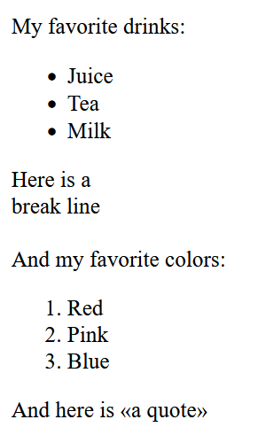

EXPLORE
30 MIN
2
Search on the internet how to make in html
List (ordered and unordered)
Line break
Quote
On which website are you looking for information ?

Slide 7
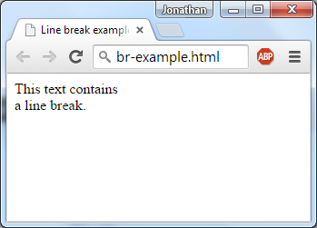
EXPLAIN
Break line
5 MIN
CLASS
The <br/> tag inserts a single line break.
Note : The break line has no end tag.
This text contains<br/>a line break

Slide 8
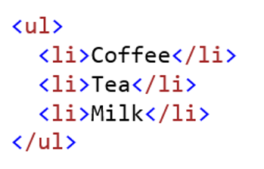
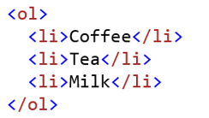
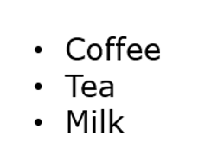
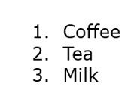
EXPLAIN
5 MIN
CLASS
Unordered List
Ordered List

Slide 9
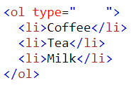





EXPLAIN
Ordered List Type
5 MIN
CLASS
1
A
a
I
i
Default

Slide 10
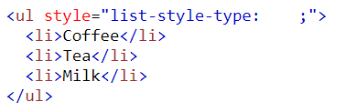




EXPLAIN
Unordered List Type
5 MIN
CLASS
disc
circle
square
none
Default

Slide 11
PRACTICE 1
10MIN
1
Write an HTML page with :
Your 5 favorite animals (unordered)
Your 5 favorite foods (ordered)

Slide 12
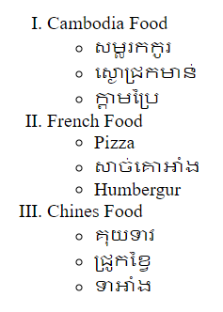
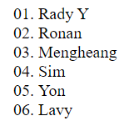
PRACTICE 2
Write an HTML page with :
30MIN
1
Exercise 1 – OL + UL
Exercise 2 – Only UL

Slide 13
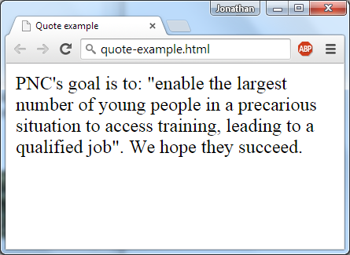
EXPLAIN
Quote tag
5 MIN
CLASS
The <q> tag defines a short quotation.
Note : <q> is an inline element because it can be put inside a line of text without affecting it
<p>PNC's goal is to: <q> enable the largest number of young people in a precarious situation to access training, leading to a qualified job </q>. We hope they succeed.</p>

Slide 14
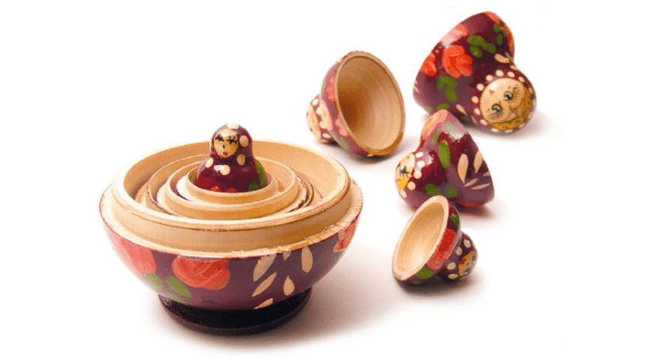
Nested elements

Slide 15
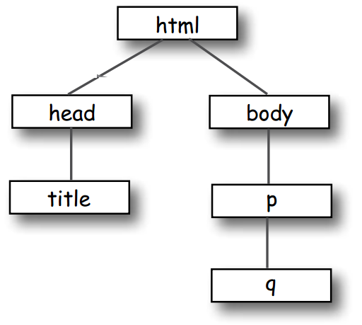
EXPLAIN
Draw a picture of nested elements !
5 MIN
CLASS
<html>
<head>
<title>Musings</title>
</head>
<body>
<p>
To quote Buckaroo,
<q>The only reason
for time is so
that everything
doesn’t happen
at once.</q>
</p>
</body>
</html>

Slide 16
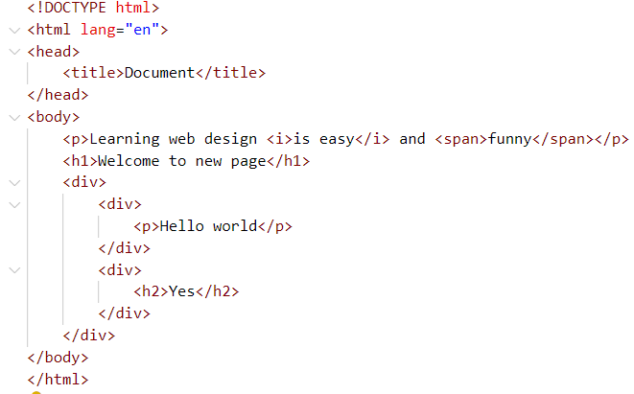
PRACTICE 1
Draw a picture of nested elements !
10MIN
1

Slide 17
PRACTICE
Nested element
20 MIN
2
Look at the file: nested-elements-errors
Some elements are not well nested : fix errors !
Draw a picture of the nested elements on paper

Slide 18


HOMEWORK
After class
INDIV
1. Complete the handout I give you now.
2. Do the required homework
3. Send your homework to Google Classroom

